Slide 1
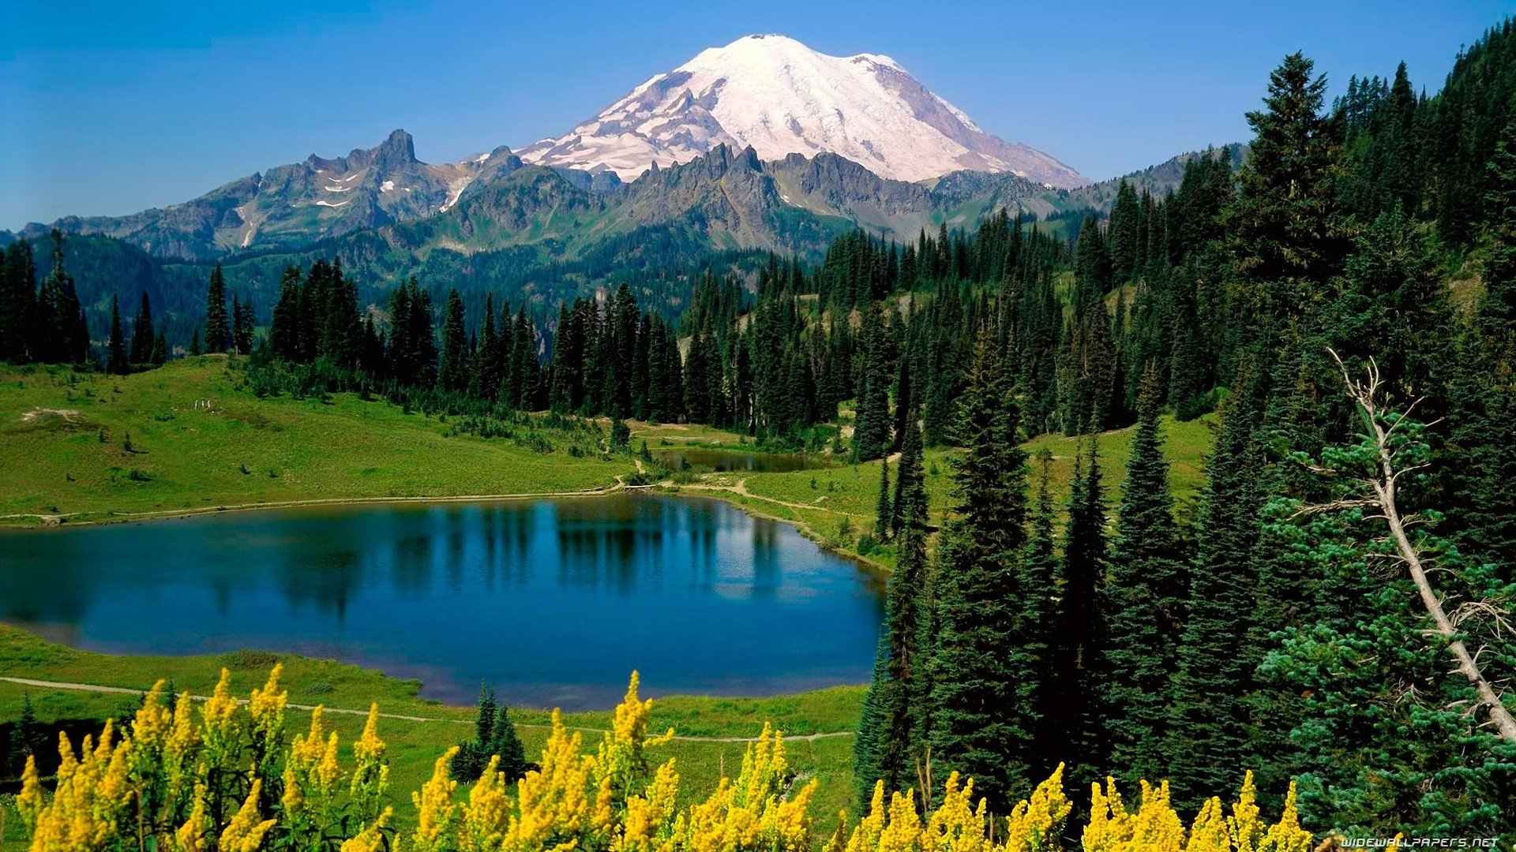
The Washington’s state
Par Gaspard et Sami

Slide 2
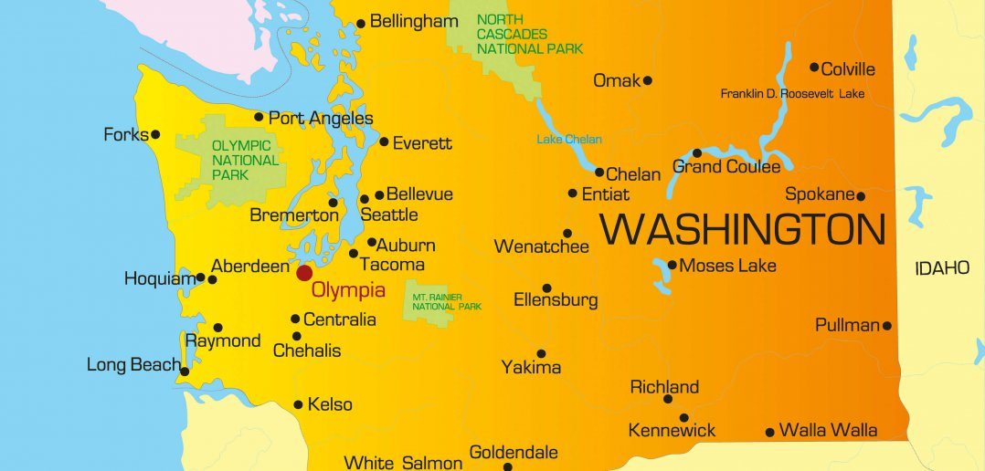
His location
The state of Washington is in the Pacific Nortwest region and is between Idaho’s state to the East and Oregon’s state to the North. This state have a coast on Ocean Pacific to the West. To finish he share a border witn Canada.

Slide 3
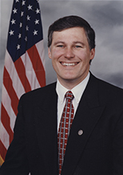
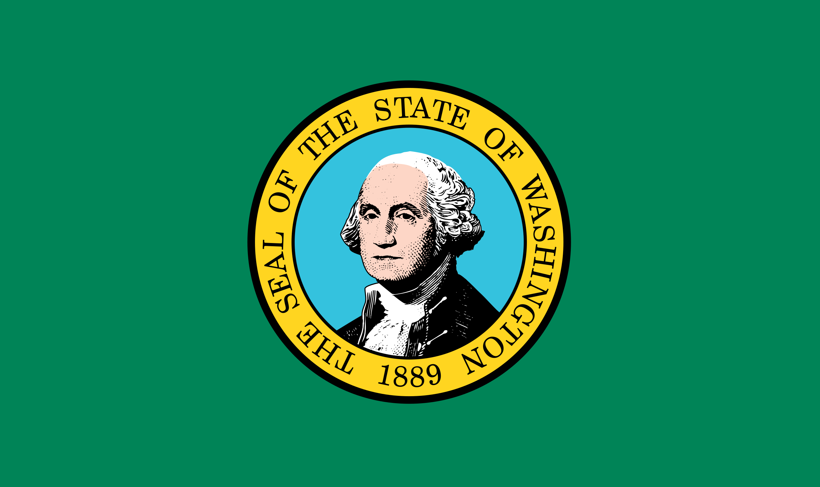
Presentation
There are 7 614 893 inhabitants in 2019 at Washington
The inhabitants are call the Washingtonians
The abreviation of the state is WA
The nickname of Washington is the Evergreen state
The gouverner
Jay Inslee
The state’s flag

Slide 4
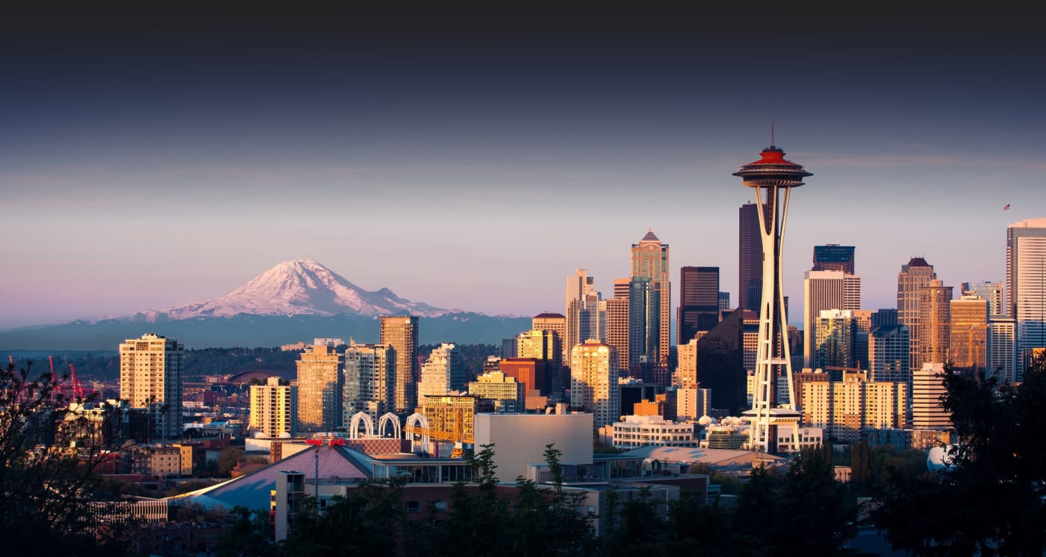
The cities
The capital of Washington is olympia but the capital isn’t the biggest city of Washington’s state. It’s only the 24e biggest city.
The biggest city of the state of Washington is seatle…

Slide 5
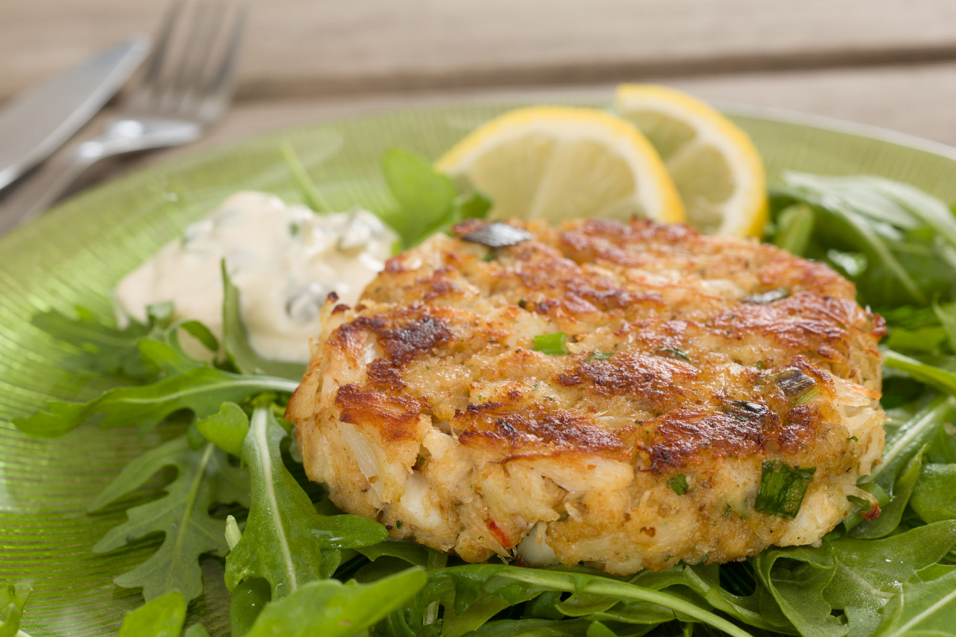
The food
The speciality of the region is the crab cake. It's fried crab meat, presented in the form of a dumpling or chopped. it's delicious and is often served with mayonnaise.

Slide 6
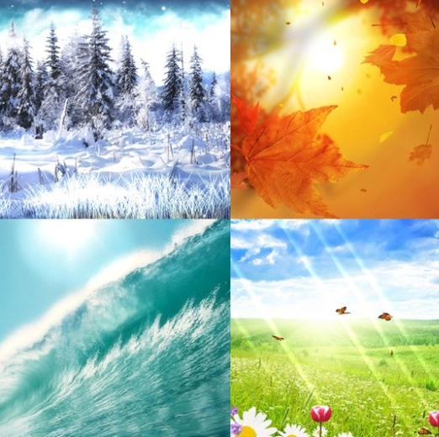
The climate
In washington the state's climate varies in the west there is a mild oceanic climate while to the east of the Cascade Range it is drier and the coast is often rainy in winter

Slide 7

The end

